Slide 1


Slide 2


Slide 16
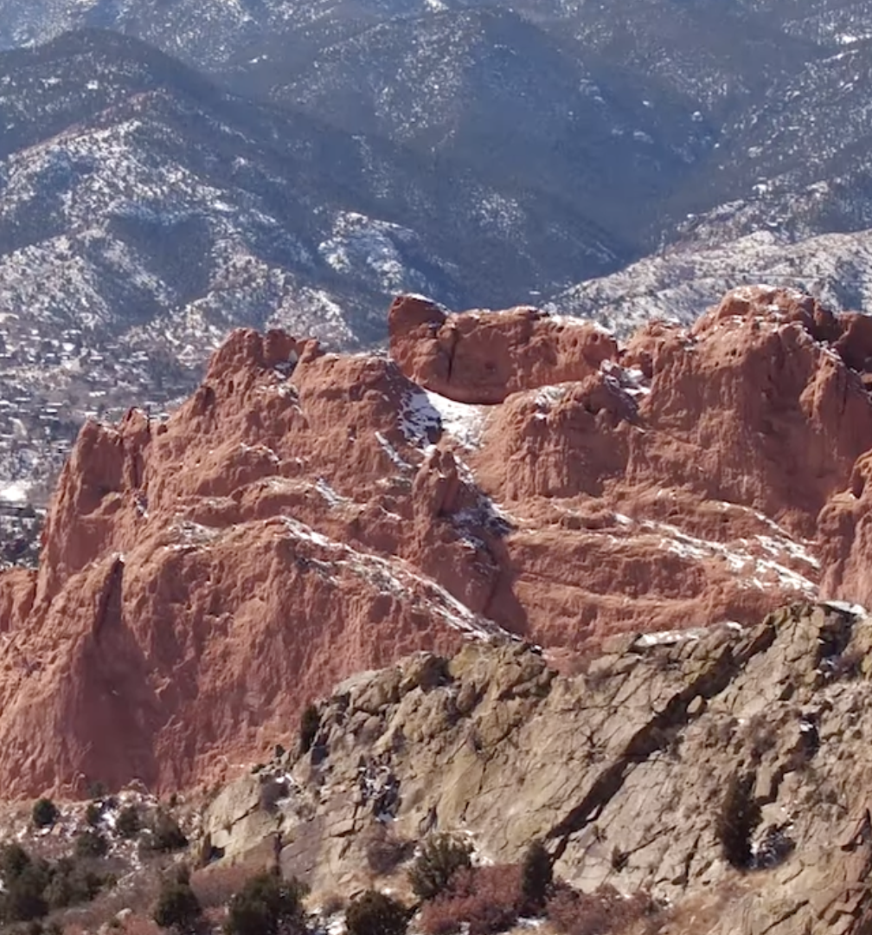
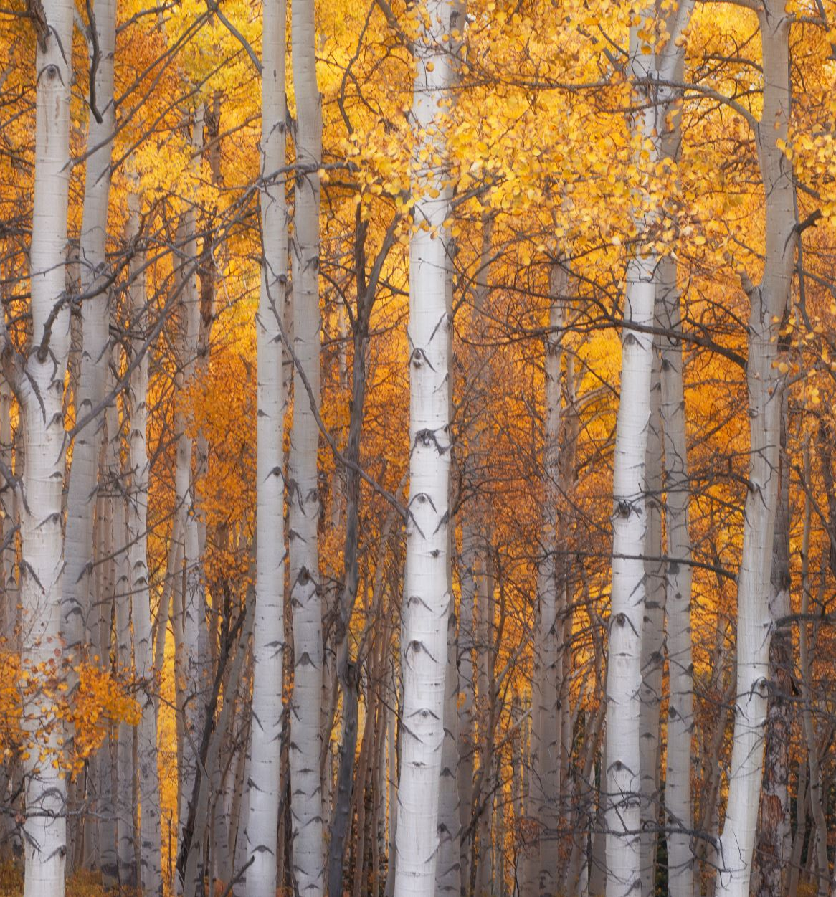

**Layout unavailable in Theme Builder**

Slide 18
Example Charts
Use these examples as a guide to build any chart or SmartArt you need.

Slide 19
Example Charts
Tuition Item | Cost
Item | $0,000
Item | $0,000
Item | $0,000
Item | $0,000
Item | $0,000
Item | $0,000
Step 1
Prospective students
Admission and yield rates
Step 2
Current students
Active promoter score
Step 3
Engaged alumni
Donations

Slide 20
Example Charts
Role
Role
Role
Role
Role
Role
“Front Doors” of the College
Students
Fine Arts Center
Athletics

Slide 21
Example Charts
Cycle phase short description
Cycle phase short description
Cycle phase short description
Cycle phase short description
Cycle phase short description
Title of Step 1
Subtext 1
Subtext 2
Title of Step 2
Subtext 1
Subtext 2
Title of Step 3
Subtext 1
Subtext 2

