Slide 1
Banner Budget Reallocation Guide

Slide 2
General Guidelines
Timeline
Using Self Service Banner to reallocate budgets
Reallocation Tips and Tricks

Slide 3
Each year, individual departments are given the opportunity to reallocate their operating budgets.
Included in this process:
  Budget reallocation for fund 110002, Unrestricted Operating Accounts (7XXXXX)
Not included in this process:
  Budget reallocation for labor
  Additional funds awarded
  Approved roll-forward funds
  Any other non-operating accounts
All accounts that do not qualify for this process will be added or reallocated by the Budget Office.
General Guidelines
Each year, individual departments are given the opportunity to reallocate their
operating budgets.
This includes:
Budget reallocation for Fund 110002, Unrestricted Operating
Accounts (7XXXXX)
Not included in this process:
Budget reallocation for labor (salaries and benefits)
Additional funds awarded
Approved roll forward funds
Any other non-operating accounts
All accounts that do not qualify for this process will be added or reallocated by the
Budget Office.

Slide 4
Timeline
April
Reallocation process opens
April - May
Departments begin reallocating budgets
May
Reallocation process closes
May
Budget Office confirms that all reallocated items were processed correctly

Slide 5
Using Self-Service Banner (SSB) to Reallocate Budgets

Slide 6
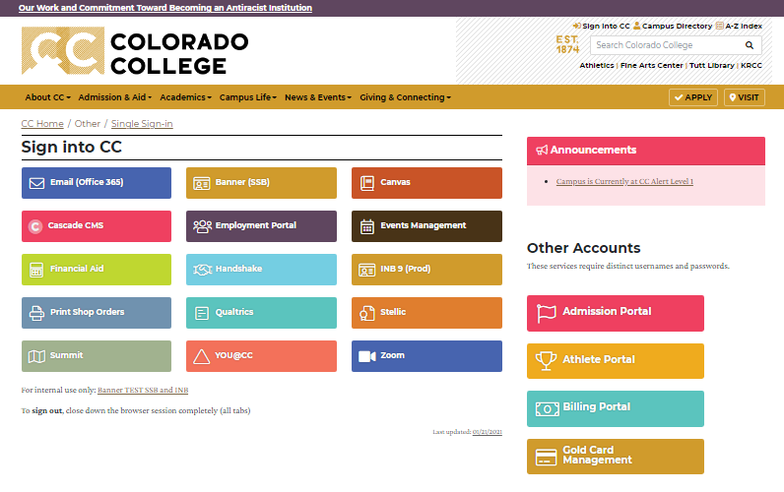
Sign in to Colorado College and select Banner (SSB).

Slide 7
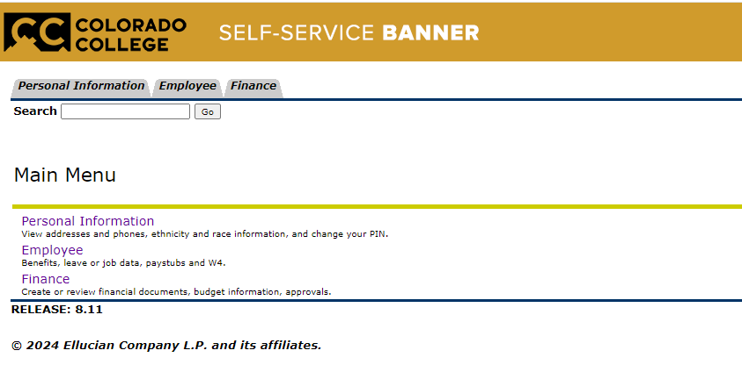
From the top of the page, select the Finance tab. Or, select Finance under the main menu.

Slide 8
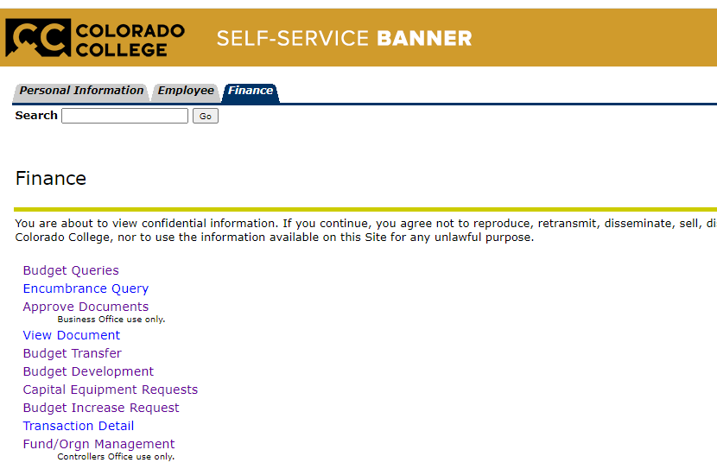
Select Budget Development.

Slide 9
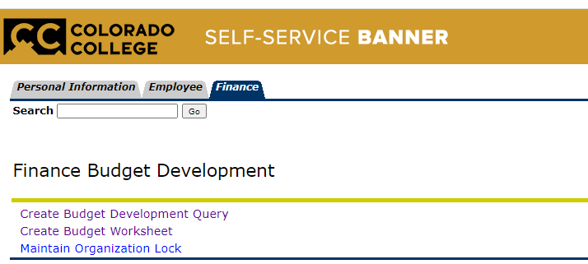

Slide 10
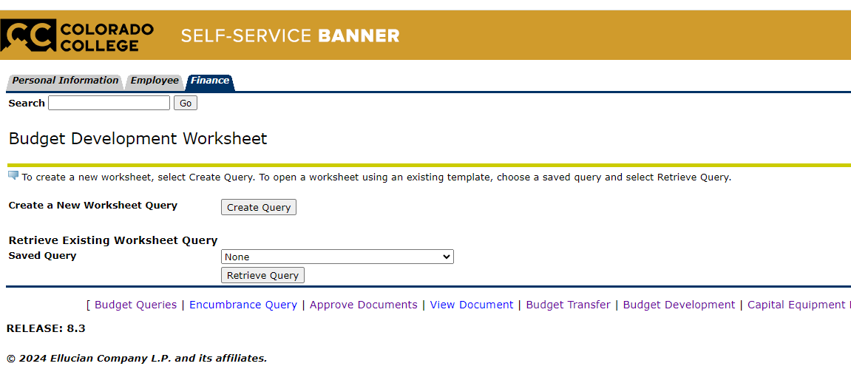

Select either “Create Query” or “Retrieve Query”.

Slide 11
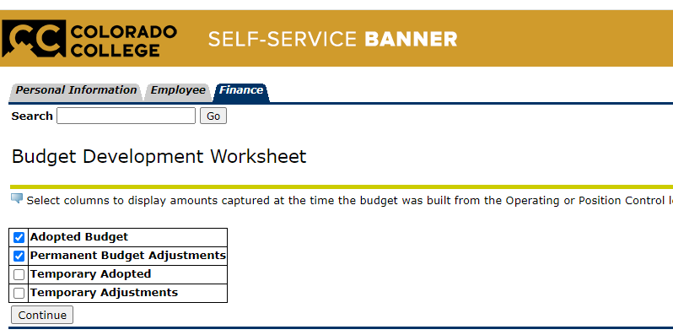
Check the boxes for “Adopted Budget” and “Permanent Budget Adjustments” only.

Slide 12
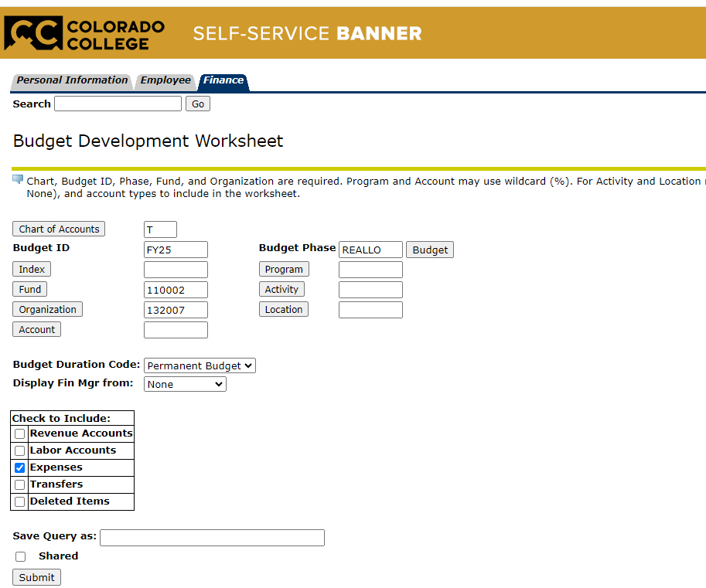
Chart of Accounts = T
Budget ID = FYXX (for example: you are reallocating for the next Fiscal Year)
Budget Phase = REALLO
Fund = 110002
Org = The organization you are changing
Budget Duration Code = Permanent
Check to include = Expenses
Save Query as = Name your query
Shared box = click only if you want others to access your query
SUBMIT

Slide 13
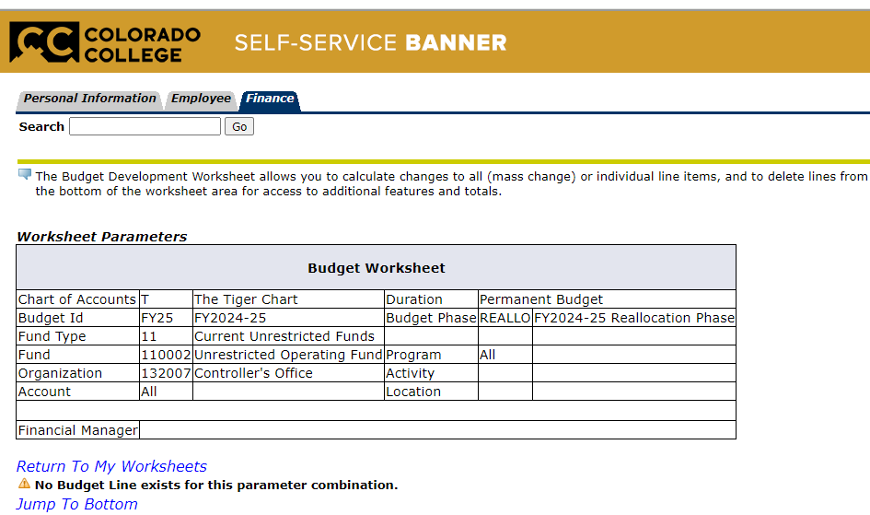
The parameters entered are summarized at the top of the page.

Slide 14
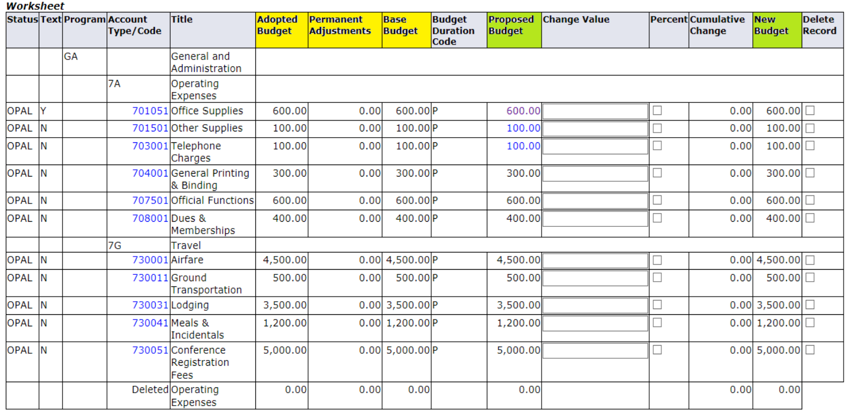
Adopted Budget = Budget loaded at the beginning of the fiscal year
Permanent Budget Adjustments = changes made during the fiscal year that will become part of your permanent budget
Base Budget = Budget after adjustments (Adopted budget +/- adjustments)

Slide 15
Initially, both the Base Budget and the Proposed Budget will be equal.
The New Budget is updated after changes are posted.

Slide 16
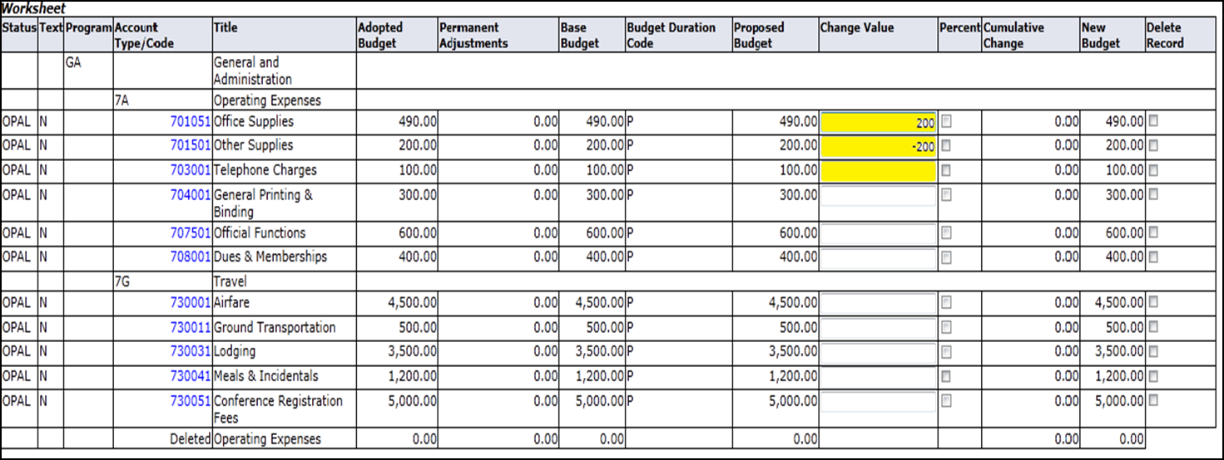
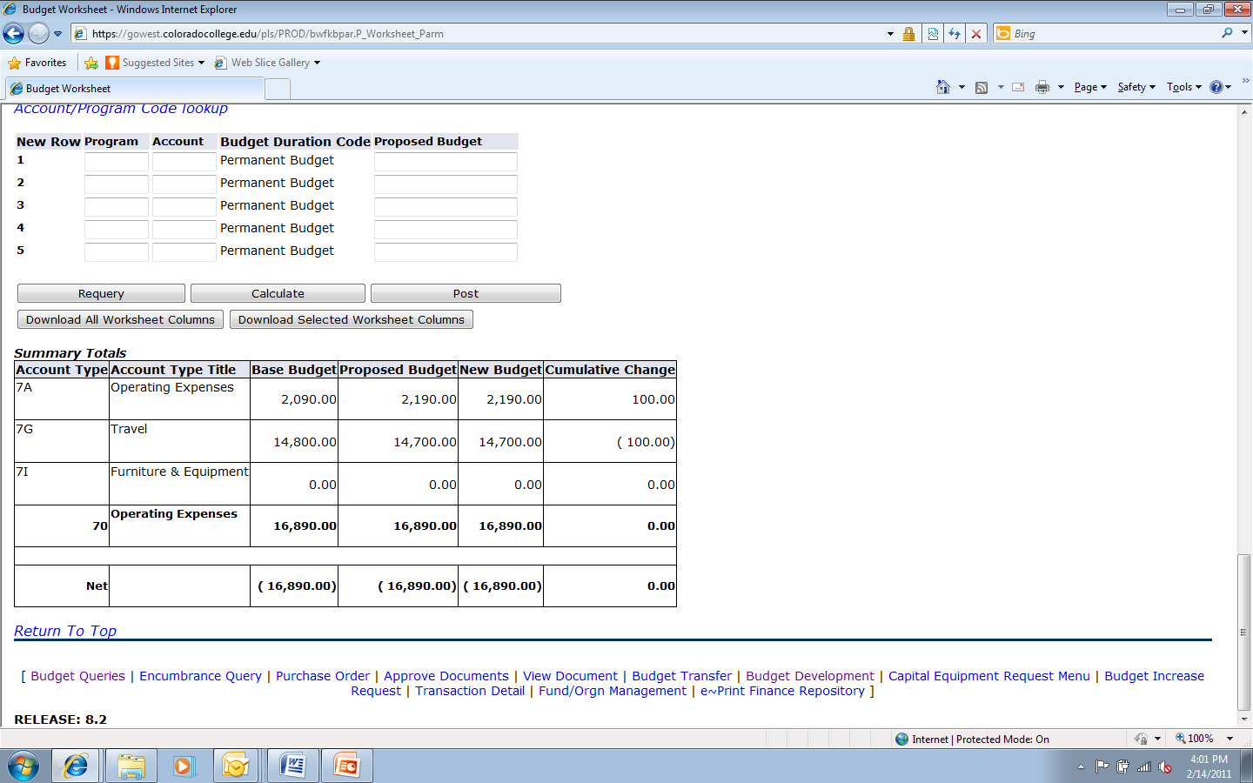
Enter all changes in the Change Value column
Scroll down and select Calculate to see the cumulative changes
To remove changes and return to the original budget, select Requery

Slide 17
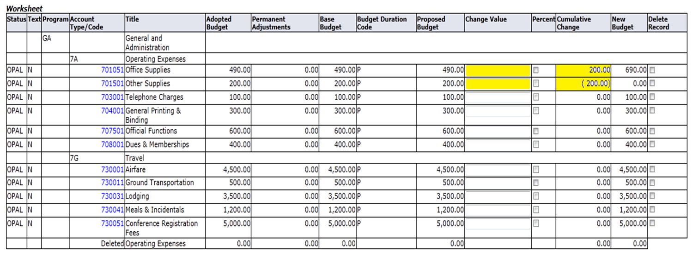
After Calculating, change values will move to the Cumulative Change column and update the New Budget
Make sure the sum of all Cumulative Changes equal Zero!
Verify the New Budget Amount is as expected and if so, select Post

Slide 18
Adding or Deleting Accounts

Slide 19
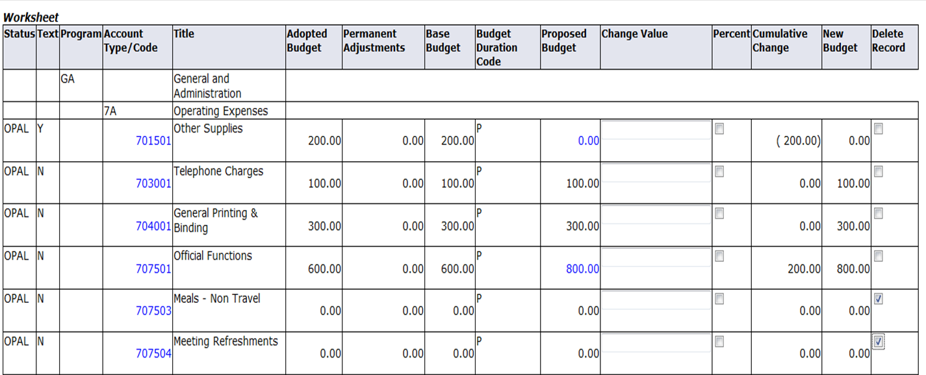
Delete an Account:
Select the Delete Record box next to the account you want to delete
If the account has an exiting budget amount, you must reallocate that amount before selecting Delete Record
Post the entry

Slide 20
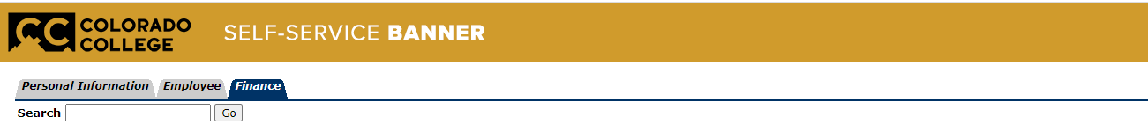
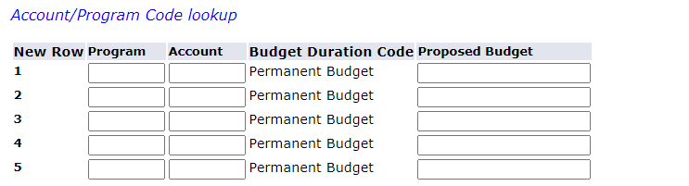
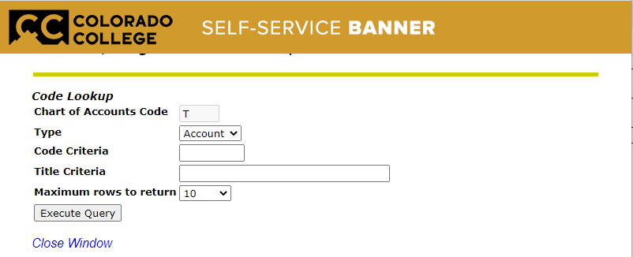
Add an Account:
Complete the Program, Account, and Proposed Budget fields
If you do not know the account, click on Account/Program Code lookup
This will bring up a new window
Here you can search by Account or Program Type
Make a note of the program/account (screen is read only)

Slide 21
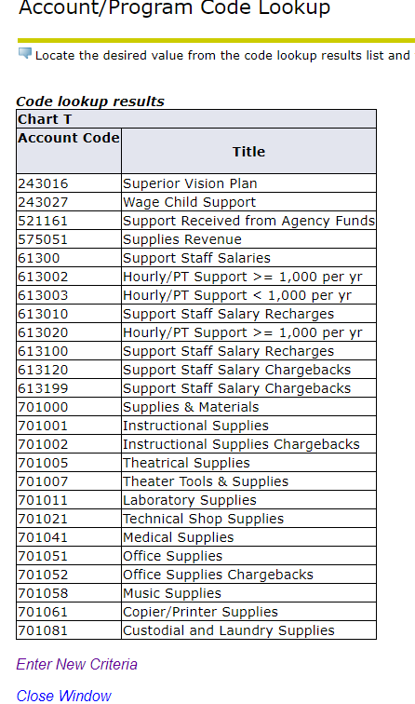
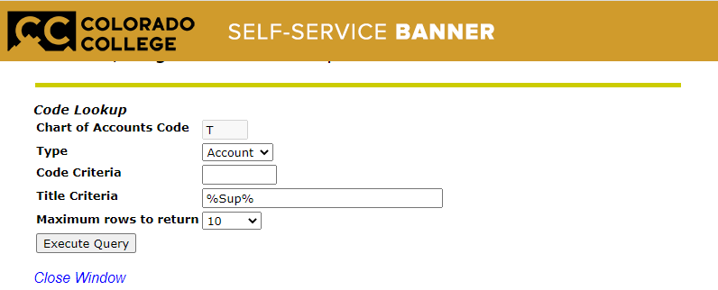
Add an Account:
Select Account
Use Wildcard (%) to find either the Account or Program
Select the Maximum rows to return for results
Execute Query to view results

Slide 22
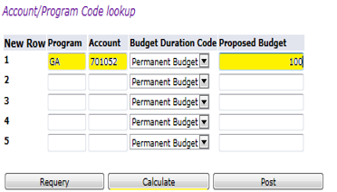
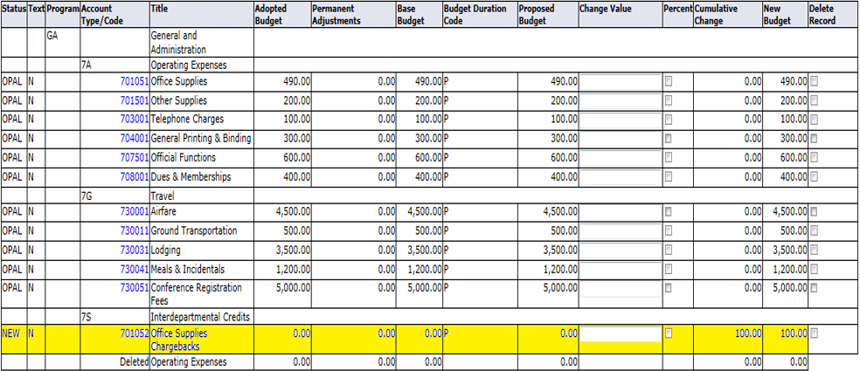
Add an Account:
Enter the Program, Account, and Proposed Budget
Calculate
The new line will be added to the worksheet

Slide 23
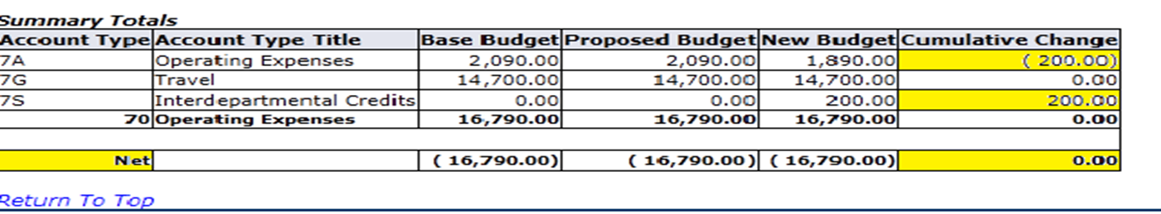
Double check changes and make certain that cumulative change equals zero!
Post the changes.
If more changes are needed after posting, simply start the process again (calculations will begin using the new proposed budget.

Slide 24
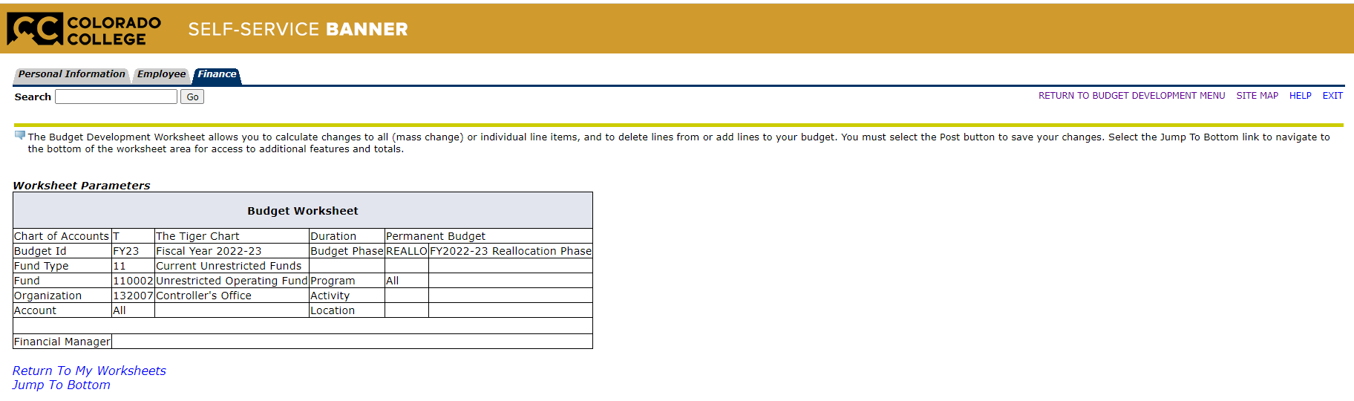
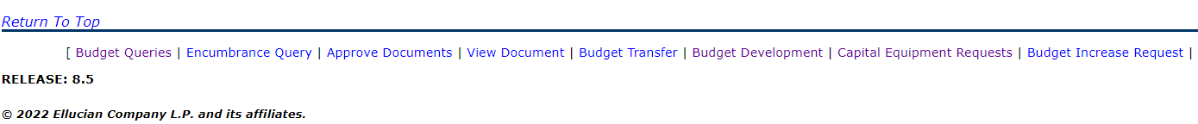
Exit the worksheet by either selecting EXIT at the top right of the page or by selecting Budget Development at the bottom of the page.

Slide 25
Reallocation
Tips and Tricks

Slide 26
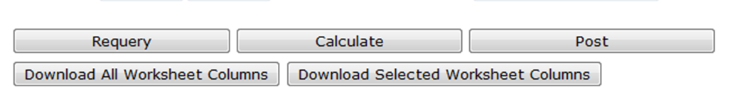
Download Option:
If you prefer to use a spreadsheet before entering changes, select Download All Worksheet Columns or Download Selected Worksheet Columns.
The primary difference is that Download All Worksheet Columns may pull in additional information that is not necessary to this process.
Note that the spreadsheet is only a guide and is not part of the Reallocation Process. You will still need to manually enter your changes.

Slide 27
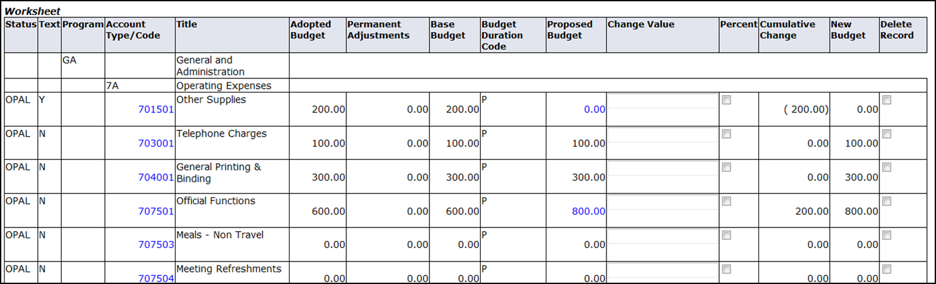
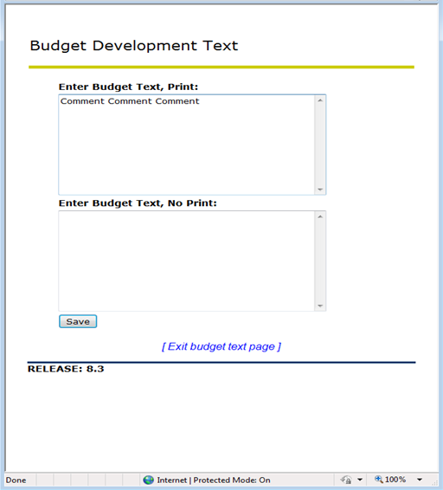
Comments Option:
To comment on changes, click on the account code
In the popup window, add comments as needed
Save
A “Y” in the Text field indicates that comments have been added to the account line

Slide 28
Thank you!

Slide 29
Need Help?
Call or email
Brian Cortez x6854
bcortez2024@coloradocollege.edu

