Slide 1


2025 Faculty Insight Forums Findings
By Cole Amaya 9/9/2025
Notes:
Good Afternoon, I’m Cole Amaya a senior here at CC. I will be presenting the findings from the 2025 faculty Insight Forums, which were co-hosted by President Whitaker, and Dean Chan.

Slide 2
Listen
Identify
Envision
To pinpoint the greatest challenges and sources of strain in their professional roles.
Collaborative structural changes that would foster a more flexible, equitable, transparent, and supportive academic environment. This, in turn, would better support all three core missions of teaching, research, and service.
To hear directly from faculty about the balance of teaching, research, and service.
Notes:
The purpose of these 2025 faculty insights forums was to delve into faculty perspectives on reimagining their professional responsibilities. The objective was to enhance the alignment of their roles with the fundamental missions of teaching, research, and service. To achieve this, we engaged in ten separate forums, actively listening to faculty members to gain firsthand insights into the details of the balance between teaching, research, and service at CC. Through rigorous analysis, we identified the most significant challenges and sources of strain that faculty encounter in their professional roles. By addressing these challenges, we can envision collaborative structural changes that would foster a more flexible, equitable, transparent, and supportive academic environment. This, in turn, would better support all three core missions of teaching, research, and service.

Slide 3
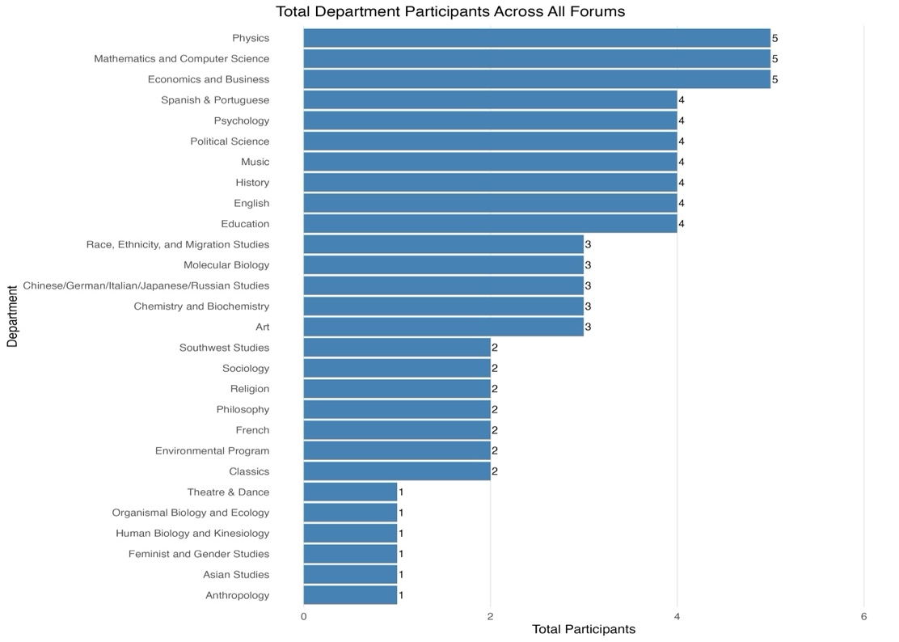
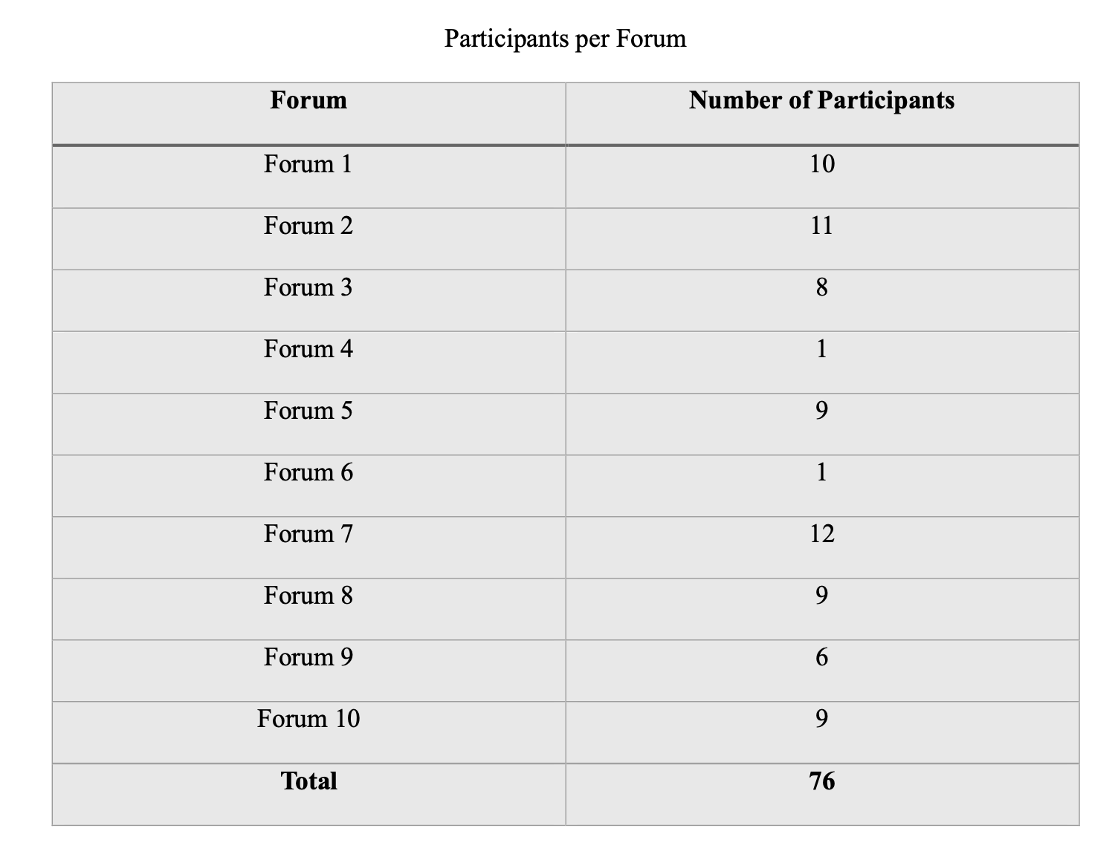
Participants
28 of the 32 Departments Included
Notes:
On to the Participants! Thank you to all the faculty members who participated and shared their lived professional experiences in these forums. Over the ten Forum sessions, 76 faculty members contributed their insights. Out of Colorado College’s 32 departments, 28 were represented across the ten forums, excluding Comparative Literature, Film & Media Studies, Geology, and General Studies.
The sessions saw a total of 76 interviewees, with eight participating in-person and two virtually. Mathematics and Computer Science, Physics, and Economics and Business departments had the most representation, with five interviewees each. In contrast, Asian Studies, Human Biology and Kinesiology, Theatre & Dance, Anthropology, Feminist and Gender Studies, and Organismal Biology and Ecology departments had the least representation, with only one interviewee per department.
For a detailed breakdown of departmental representation, please refer to the right-hand side of the slide, this presentation will also be available following this session.

Slide 4
Essential Questions
1. “How do you currently balance teaching, research, and service responsibilities? What aspects of these roles do you see as most vital to fulfilling our mission and which feel most challenging or burdensome?”
2. “If you could reimagine your professional responsibilities, what changes would allow you to devote more time to what you find most impactful for students, whether that’s teaching, research, or service?”
3. “What strategies or structural changes could help you engage more deeply with research, especially in the context of maintaining continuity during busy teaching or service periods?”
4. “What kinds of support, resources, or institutional changes would help reduce strain and enhance your sense of accomplishment and impact in your professional role?”
Notes:
To guide the faculty insight forums the discussions were centered around four essential questions.
First, “How do you currently balance teaching, research, and service responsibilities? What aspects of these roles do you see as most vital to fulfilling our mission and which feel most challenging or burdensome?”
Second, “If you could reimagine your professional responsibilities, what changes would allow you to devote more time to what you find most impactful for students, whether that’s teaching, research, or service?”
Third, “What strategies or structural changes could help you engage more deeply with research, especially in the context of maintaining continuity during busy teaching or service periods?”
And Finally, “What kinds of support, resources, or institutional changes would help reduce strain and enhance your sense of accomplishment and impact in your professional role?”

Slide 5
How do the faculty FEEL?
Notes:
To truly understand the faculty experiences and the rich perspectives from the forums, we needed to jump into this analysis asking, the most important question “HOW DO THE FACULTY FEEL?”

Slide 6
Quantitative
Qualitative
Method: A custom Python program using a pre-trained machine learning model to analyze the raw text data.
Purpose: To systematically measure the emotional landscape of the discussions and create a quantitative "emotional profile".
This Measured:
Sentiment Classification: A binary score for each transcript (Positive / Negative).
Emotional States: A full probability distribution for emotions like joy, sadness, anger, fear, surprise, and disgust.
Method: A comprehensive thematic analysis to identify recurring patterns. These themes were then meticulously cross-referenced with the quantitative emotion scores to understand the context behind the feelings.
Purpose: To identify the core patterns, prevalent sentiments, and root causes behind the emotions measured in the quantitative analysis.
This Identified:
Recurring Themes: The core ideas and concerns that faculty raised repeatedly.
Nuanced Context: The "why" behind the data, understanding the specific situations that generated feelings of joy, fear, etc.
Notes:
To analyze how the faculty feel, we used a mixed method approach of quantitative and qualitative analysis methods. First, the quantitative piece. We used a custom Python program with a pre-trained machine learning model to systematically analyze the raw text data for every single transcript of each forum. The purpose here was to get an objective measure of the emotional landscape to create a data-driven 'emotional profile' for each discussion. This gave us the 'what': a clear picture of the overall sentiment, was it positive or negative?, and the specific emotional states, like joy, fear, and anger, and more that were present.
But numbers don't tell the whole story. So, at the same time, we conducted a deep qualitative analysis. A comprehensive thematic analysis to identify recurring patterns. These themes were then meticulously cross-referenced with the quantitative emotion scores to understand the context behind the feelings. And the crucial step here was cross-referencing. We meticulously compared the themes we identified with the quantitative emotion scores. This identified, Recurring Themes: The core ideas and concerns that faculty raised repeatedly. As well as Nuanced Context: The "why" behind the data, understanding the specific situations that generated feelings of joy, fear, etc.

Slide 7
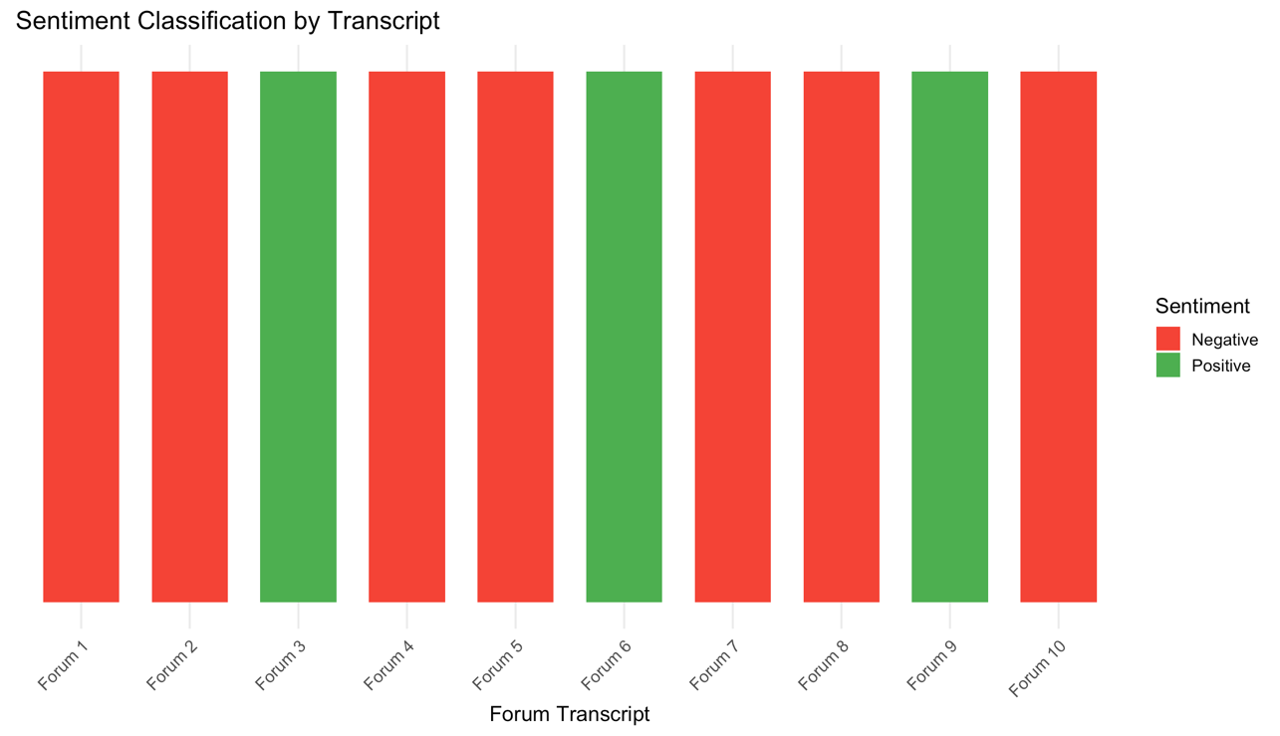
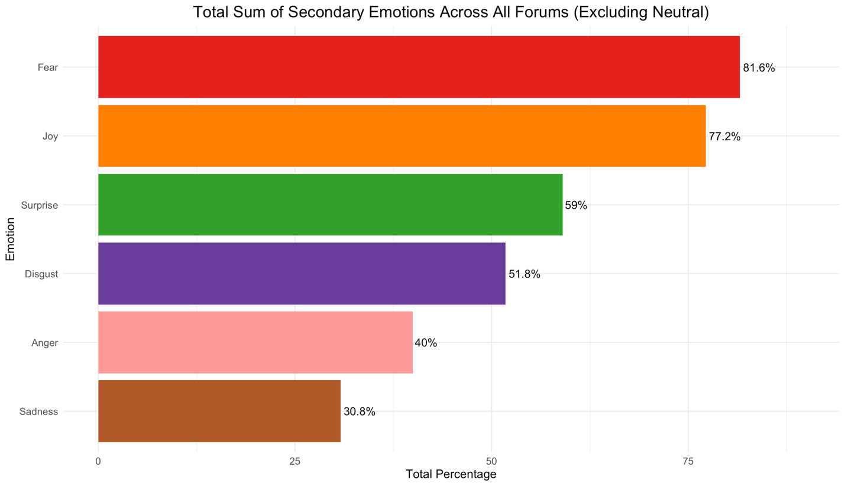
Overall Sentiment and Emotion
Notes:
Let’s start with the quantitative data.
Through out the discussions the underlying emotional tone, as measured by our analysis, was predominantly negative. As you can see here, seven of the ten forums were classified with an overall negative sentiment. This was the first major indicator that there were significant undercurrents of concern and frustration.
But 'negative' is a broad term. To understand what was really going on, we looked at the specific emotions that were most prevalent, excluding neutrality. At the very top, in over 81% of the discussions, was fear. When we look at the context, this fear was consistently linked to feeling 'maxed out,' overworked, and concerned about a 'chilling effect’, and lack of accountability on campus."
But right behind fear, in over 77% of transcripts, was its opposite: joy. This joy was a powerful and consistent theme, stemming almost exclusively from the core mission: the love of teaching, the 'beautiful work' in the classroom, and the way teaching 'infuses' and keeps the fire alive for research.
Next, we see surprise. This was a fascinating, double-edged emotion. It appeared in moments of positive discovery, like a faculty member realizing the 'amazing' difference an extra research block made. But it also surfaced in moments of negative realization, expressing shock at a lack of support or an institutional inequity.
Following that are two powerful negative emotions: disgust and anger. The disgust was often directed at administrative burdens, with one department chair describing their role as a 'death by 1000 paper cuts.' The anger was a response to feeling unsupported, with one faculty member asking why they should celebrate an achievement the college since they 'made it almost impossible to do.' And finally, we see sadness. This was often tied to a sense of professional loss or compromise—the painful acknowledgment of a 'truncated' research career, or the 'heartbreaking' drop in student engagement at academic events and in-class attendance.
So, when you look at this full emotional landscape, you see the central tension of our findings. There is a deep and genuine joy that faculty feel in their core work of teaching and research. But that joy is being actively eroded and overshadowed by powerful, negative emotions—fear, disgust, anger, and sadness—that stem directly from structural and administrative burdens.

Slide 8
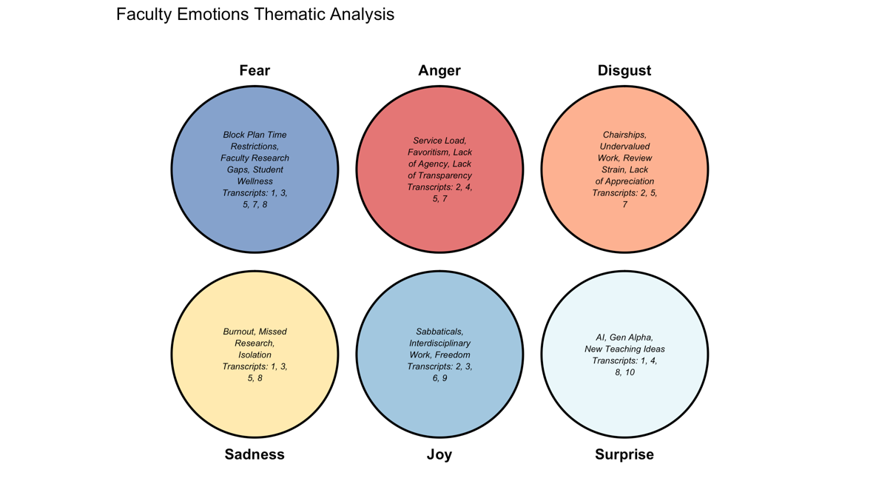
Notes:
We have a clear picture of the emotional landscape, encompassing a mix of joy, fear, anger, and other powerful emotions. However, our analysis now takes us a step further by directly linking these emotions to the specific reoccurring themes discussed by faculty.
Let’s begin with the negative emotions, as depicted in the top row. They cluster prominently around issues of workload, institutional processes, and a lack of support.
Fear, rooted in a profound sense of being overwhelmed, stems primarily from the relentless pace and time constraints of the Block Plan. Faculty didn’t merely describe their busyness; they used words like ‘terror’ when contemplating the daunting task of building new classes from scratch, expressing a feeling of being ‘really maxed out.’ This fear extends beyond personal stress, directly impacting their work, creating gaps in their research, and raising concerns about the well-being of fellow colleagues and students under the constant pressure.
Anger, on the other hand, is primarily driven by the service load. However, it goes beyond the sheer amount of work. The anger arises from a perceived lack of agency, and a lack of transparency in decision-making, and a sense that favoritism can sometimes influence outcomes. This creates a feeling of powerlessness.
Disgust is linked to what many perceive as undervalued labor. It stems from the immense, often invisible strain of chairships and personnel reviews, and a feeling that this essential work goes without adequate appreciation or support.
Thus, the story of negative emotions is a narrative of institutional friction.
Now, let’s delve into the bottom row, which narrates the story of the academic mission itself, encompassing both its triumphs and challenges.
Sadness emerges as the emotional toll. It manifests as burnout from the intense pace, professional isolation, and the painful realization of missed research opportunities or a truncated research career.
In stark contrast, we encounter Joy. The sources of this joy are incredibly revealing. It stems from sabbaticals, the freedom of interdisciplinary work—essentially, from the moments when structural constraints are removed, allowing faculty to fully immerse themselves in the intellectual work they cherish.
Finally, Surprise emerges as the emotion of discovery. It encompasses the positive excitement of new teaching ideas and the potential of innovative tools like AI. However, it can also be the negative shock of uncovering an unexpected institutional problem or learning about the lack of support incertain endeavors.
This diagram effectively illustrates the fundamental conflict at the heart of the faculty experience. The negative emotions are almost exclusively generated by the burdens and structures of the institution, while the positive emotions arise from the core academic work of teaching and research.
The central challenge, therefore, becomes evident: how can we minimize the factors that evoke fear, anger, and disgust, thereby creating more space for the elements that bring joy? This leads us directly to the four major findings that emerged from this analysis.

Slide 9
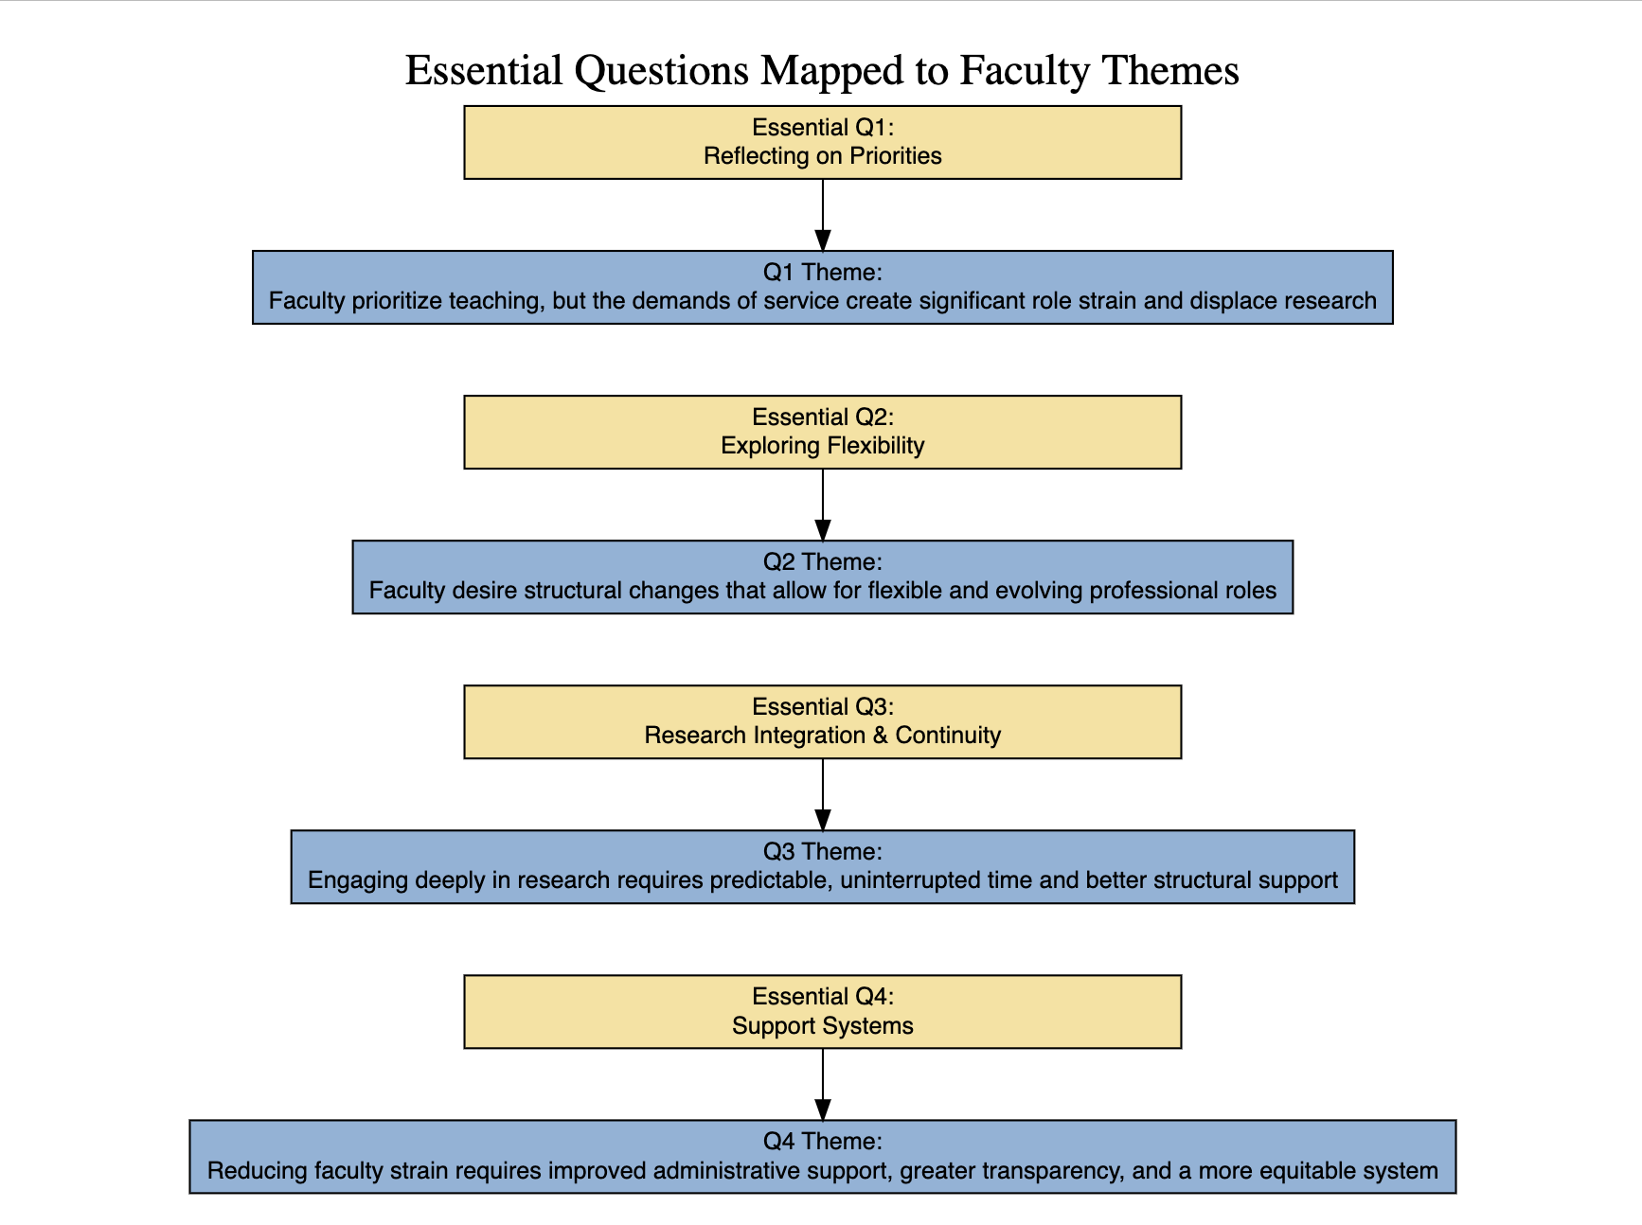
Notes:
The final step in our analysis was to map these themes directly back to the four essential questions that guided this entire project. This flowchart shows how the reoccurring themes we identified from the faculty insight forums, logically correspond to the questions we asked.
We started by asking our first question, about priorities and burdens. The answer that came back was unequivocal, forming our first theme: 'Faculty prioritize teaching, but the demands of service create significant role strain and displace research.' While teaching was consistently described as the most vital and rewarding part of the job, the report makes clear that service is the most challenging. It's frequently described as 'unpredictable, heavy, and disproportionately distributed,' and this is where we see the negative emotions manifest—specifically fear, disgust, sadness, and anger. The burden of service is not just an inconvenience; it's a primary source of frustration that actively impedes faculty's ability to engage in their other core missions they came to CC for.
Our second question pushed the conversation toward exploring flexibility. The response was a powerful and unified call for change, forming our second theme: 'Faculty desire structural changes that allow for flexible and evolving professional roles.' The forums revealed a primary desire to move away from what the report calls a 'one-size-fits-all' model. The current rigidities are a source of negative sentiment. The prospect of change, however, elicited joy and surprise. As one professor memorably stated, the college needs to 'think a lot more creatively' and not insist that their 'wants and needs and desires be the same at 43 years old as they were when I was 28.' This isn't just about minor tweaks; it's about fundamentally rethinking how a career at CC can evolve.
Our third question focused on research integration and continuity, and in doing so, it highlighted what the report calls a 'major area of struggle.' This led directly to our third theme: 'Engaging deeply in research requires predictable, uninterrupted time and better structural support.' Faculty articulated the immense difficulty of sustaining research amidst heavy teaching loads and, specifically, the 'unpredictable nature of the Block Plan.' This is a significant source of negative sentiment, and it's where we see the emotion of fear surface prominently—fear about the ability to meet research expectations and advance scholarly work without adequate institutional support and, crucially, protected time.
Finally, our fourth question asked about support systems. This elicited a wide range of needs, culminating in our final theme: 'Reducing faculty strain requires improved administrative support, greater transparency, and a more equitable system.' The report shows that discussions around the current deficiencies in support systems frequently manifested in negative sentiment, accompanied by anger, disgust, and sadness. There was a strong call for concrete changes, from clearer committee structures and better distribution of service tasks to increased funding for student research and resources to address faculty well-being.
As this mapping clearly demonstrates, there is a direct and powerful throughline from the questions we posed to the discussions the faculty provided. The themes that emerged were a direct and evidence-based response to the core challenges posed by the essential questions.

Slide 10
Conclusion
Notes:
The Faculty Insight Forum Transcripts yielded a rich understanding of faculty experiences, combining in-depth qualitative insights with quantitative sentiment analysis. A predominant and recurring theme was the significant strain imposed by the perceived burden and unpredictable nature of service responsibilities. This consistently generated negative sentiment and emotions such as fear, anger, disgust, and sadness, often overshadowing the intrinsic value and satisfaction faculty derive from their teaching and research pursuits. The forums highlighted a palpable desire for greater flexibility and dedicated time for scholarly work, underscoring a clear need for structural adjustments to enhance research integration and continuity, especially given the unique demands of the block plan. While challenges were prominent, the discussions also revealed moments of joy and positive sentiment linked to faculty appreciation for aspects of their roles, existing support mechanisms, and the potential for positive institutional change.
Ultimately, these discussions underscore a critical imperative; to re-evaluate workload distribution, streamline administrative processes, and bolster comprehensive support systems. Such strategic changes are essential to fostering a more sustainable and fulfilling professional environment that empowers faculty to pursue research opportunities and effectively engage with their students.

Slide 11
2025 Faculty Insight Forums Findings
By Cole Amaya 9/9/2025
Notes:
Thank You for your time. I will now turn it over to President Whitaker and Dean Chan to discuss the next steps stemming from these findings.

